Slide 1
System Analysis and Design (SAD)

Slide 2
MODULE 1
Systems Development Environment

Slide 3
Software engineering process
Software is more than just a program code.
A program is an executable code, which serves some computational purpose.
Software is considered to be collection of executable programming code, associated libraries and documentations. Software, when made for a specific requirement is called software product.
Engineering on the other hand, is all about developing products, using well-defined, scientific principles and methods.

Slide 4
Software Engineer Vs Software Developer
Who is a Software Engineer?
A software engineer is a professional who applies the principles of software engineering for designing, development, maintenance, testing, and evaluation of computer software.
Who is a Software Developer?
Software developer is a professional who builds software which runs across various types of computers.
They write code from scratch. The application could be a desktop application like Photoshop, mobile apps like Instagram, web apps like Facebook, and Twitter.
Software Process
A software process (also knows as software methodology) is a set of related activities that leads to the production of the software.
These activities may involve the development of the software from the scratch, or, modifying an existing system.

Slide 5
Any software process must include the following four activities:
Software specification (or requirements engineering):
Define the main functionalities of the software and the constraints around them.
Software design and implementation: The software is to be designed and programmed.
Software verification and validation:
Verification is the process of checking that the software meets the specification. Are we building the system right?
Validation is the process of checking whether the specification captures the customer’s needs. Are we building the right system?
Software evolution (software maintenance): The software is being modified to meet customer and market requirements changes.

Slide 6
APPROACHES TO SYSTEM DEVELOPMENT
Structured/Waterfall
Prototyping
Rapid Application Development (RAD)
Modeling: use CASE

Slide 7
APPROACHES TO SYSTEM DEVELOPMENT
Waterfall Model/Structured
The Waterfall Model was the first Process Model to be introduced. It is also referred to as a linear-sequential life cycle model.
It is very simple to understand and use.
In a waterfall model, each phase must be completed before the next phase can begin and there is no overlapping in the phases.

Slide 8
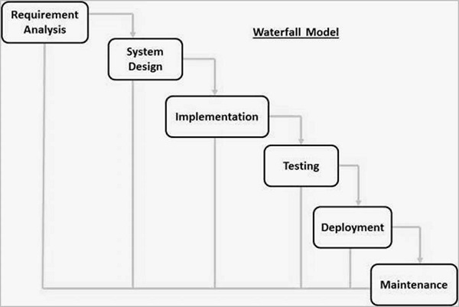
Illustration of the different phases of the Waterfall Model.

Slide 9
Phases of Waterfall Model
Requirement analysis
All possible requirements of the system to be developed are captured in this phase and documented in a requirement specification document. (Detailed requirements of the software to be developed are gathered from client).
System Design
This system design helps in specifying hardware and system requirements and helps in defining the overall system architecture.
Here you come up with a blue print of the system to be developed.
System Implementation
With inputs from the system design, the system is first developed in small programs called units, which are integrated in the next phase. Each unit is developed and tested for its functionality, which is referred to as Unit Testing.
After design stage, it is built stage, that is nothing but coding the software

Slide 10
Phases of Waterfall Model
System Testing
All the units developed in the implementation phase are integrated into a system after testing of each unit.
In this phase, you test the software to verify that it is built as per the specifications given by the client.
Deployment of system
Once the functional and non-functional testing is done; the product is deployed in the customer environment or released into the market.
Functional Testing is the type of testing done against the business requirements of an application.
Non-Functional Testing is the type of testing done against the non functional requirements.
Maintenance
There are some issues which come up in the client environment.
To fix those issues, patches are released.
Also to enhance the product some better versions are released.
Maintenance is done to deliver these changes in the customer environment.

Slide 11
Application of Waterfall Model
Requirements are not changing frequently
Application is not complicated and big
Project is short
Requirement is clear
Environment is stable
Technology and tools used are not dynamic and is stable
Resources are available and trained

Slide 12
Advantages of Waterfall Model
Simple and easy to understand and use
Easy to manage due to the rigidity of the model. Each phase has specific deliverables and a review process.
Phases are processed and completed one at a time.
Works well for smaller projects where requirements are very well understood.
Clearly defined stages.
Well understood milestones.
Easy to arrange tasks.
Process and results are well documented.

Slide 13
Disadvantages of Waterfall Model
No working software is produced until late during the life cycle.
High amounts of risk and uncertainty.
Not a good model for complex and object-oriented projects.
Poor model for long and ongoing projects.
Not suitable for the projects where requirements are at a moderate to high risk of changing. So, risk and uncertainty is high with this process model.
It is difficult to measure progress within stages.
Cannot accommodate changing requirements.
Adjusting scope during the life cycle can end a project.
Integration is done as a "big-bang. at the very end, which doesn't allow identifying any technological or business bottleneck or challenges early.

Slide 14
Prototype Model
What is Software Prototyping?
Prototype is a working model of software with some limited functionality.
Prototyping is used to allow the users evaluate developer proposals and try them out before implementation.
Software prototyping model works best in scenarios where the project's requirement are not known.

Slide 15
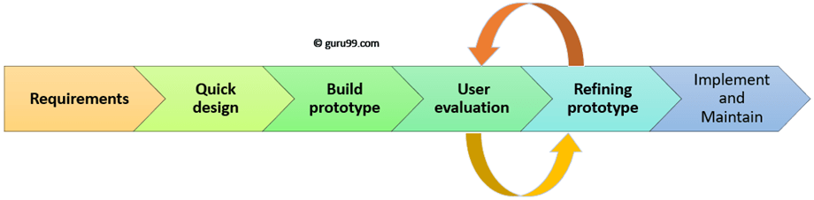
Illustration of the different phases of the Prototype Model
.

Slide 16
Phases of Software Prototype Model
Step 1: Requirements gathering and analysis
A prototyping model starts with requirement analysis.
In this phase, the requirements of the system are defined in detail.
During the process, the users of the system are interviewed to know what is their expectation from the system.
Step 2: Quick design
The second phase is a preliminary design or a quick design. In this stage, a simple design of the system is created.
However, it is not a complete design. It gives a brief idea of the system to the user. The quick design helps in developing the prototype.
Step 3: Build a Prototype
In this phase, an actual prototype is designed based on the information gathered from quick design.
It is a small working model of the required system.

Slide 17
Phases of Software Prototype Model
Step 4: Initial user evaluation
In this stage, the proposed system is presented to the client for an initial evaluation. It helps to find out the strength and weakness of the working model.
Comments and suggestions are collected from the customer and provided to the developer.
Step 5: Refining prototype
If the user is not happy with the current prototype, you need to refine the prototype according to the user's feedback and suggestions.
This phase will not over until all the requirements specified by the user are met.
Once the user is satisfied with the developed prototype, a final system is developed based on the approved final prototype.
Step 6: Implement Product and Maintain
Once the final system is developed based on the final prototype, it is thoroughly tested and deployed to production.
The system undergoes routine maintenance for minimizing downtime and prevent large-scale failures.

Slide 18
Types of software prototypes
Throwaway/Rapid Prototyping
It is quickly developed to show how the requirement will look visually.
The customer's feedback helps drives changes to the requirement, and the prototype is again created until the requirement is baselined.
In this method, a developed prototype will be discarded and will not be a part of the ultimately accepted prototype.
This technique is useful for exploring ideas and getting instant feedback for customer requirements.
Evolutionary Prototyping
Here, the prototype developed is incrementally refined based on customer's feedback until it is finally accepted.
It helps you to save time as well as effort. That's because developing a prototype from scratch for every interaction of the process can sometimes be very frustrating.
This model is helpful for a project which uses a new technology that is not well understood. It is also used for a complex project where every functionality must be checked once.
It is helpful when the requirement is not stable or not understood clearly at the initial stage.

Slide 19
Types of software prototypes
Incremental Prototyping
Incremental prototyping refers to building multiple functional prototypes of the various sub-systems and then integrating all the available prototypes to form a complete system.
This method is helpful to reduce the feedback time between the user and the application development team.
Extreme Prototyping
Extreme prototyping is used in the web development domain. It consists of three sequential phases. First, a basic prototype with all the existing pages is presented in the HTML format.
This process is called Extreme Prototyping used to draw attention to the second phase of the process, where a fully functional UI is developed with very little regard to the actual services.

Slide 20
Software Prototyping - Application
You should use Prototyping when the requirements are unclear
It is important to perform planned and controlled Prototyping.
Regular meetings are vital to keep the project on time and avoid costly delays.
The users and the designers should be aware of the prototyping issues and pitfalls.
At a very early stage, you need to approve a prototype and only then allow the team to move to the next step.
In software prototyping method, you should never be afraid to change earlier decisions if new ideas need to be deployed.
You should select the appropriate step size for each version.
Implement important features early on so that if you run out of the time, you still have a worthwhile system

Slide 21
Advantages of the Prototyping Model
Increased user involvement in the product even before its implementation.
Since a working model of the system is displayed, the users get a better understanding of the system being developed.
Reduces time and cost as the defects can be detected much earlier.
Quicker user feedback is available leading to better solutions.
Missing functionality can be identified easily.
Confusing or difficult functions can be identified.
It also identifies the complex or difficult functions.
Encourages innovation and flexible designing.
It is a straightforward model, so it is easy to understand.
No need for specialized experts to build the model

Slide 22
Disadvantages of the Prototyping Model
Prototyping is a slow and time taking process.
The cost of developing a prototype is a total waste as the prototype is ultimately thrown away.
Prototyping may encourage excessive change requests.
Some times customers may not be willing to participate in the cycle which results into longer time duration.
There may be far too many variations in software requirements when each time the prototype is evaluated by the customer.
Poor documentation because the requirements of the customers are changing.
It is very difficult for software developers to accommodate all the changes demanded by the clients.
After seeing an early prototype model, the customers may think that the actual product will be delivered to him soon.
The client may lose interest in the final product when he or she is not happy with the initial prototype.
Developers who want to build prototypes quickly may end up building sub-standard development solutions.

Slide 23
SDLC - RAD Model
What is RAD?
Rapid application development is a software development methodology that uses minimal planning in favor of rapid prototyping.
A prototype is a working model that is functionally equivalent to a component of the product.
The most important aspect for this model to be successful is to make sure that the prototypes developed are reusable.

Slide 24
Phases of the RAD Model
Business Modeling
The information flow among business functions is defined by answering questions like what data drives the business process, what data is generated, who generates it, where does the information go, who process it and so on.
Data Modeling
The data collected from business modeling is refined into a set of data objects (entities) that are needed to support the business. The attributes (character of each entity) are identified, and the relation between these data objects (entities) is defined.

Slide 25
Phases of the RAD Model
Process Modeling
The information object defined in the data modeling phase are transformed to achieve the data flow necessary to implement a business function. Processing descriptions are created for adding, modifying, deleting, or retrieving a data object.
Application Generation
Automated tools are used to facilitate construction of the software; even they use the 4th GL techniques.
Testing and Turnover
Many of the programming components have already been tested since RAD emphasis reuse. This reduces the overall testing time. But the new part must be tested, and all interfaces must be fully exercised.

Slide 26
RAD Model - Application
When the system should need to create the project that modularizes in a short span time (2-3 months).
When the requirements are well-known.
When the technical risk is limited.
When there's a necessity to make a system, which modularized in 2-3 months of period.
It should be used only if the budget allows the use of automatic code generating tools.

Slide 27
Advantages of the RAD Model
Changing requirements can be accommodated.
Progress can be measured.
Iteration time can be short with use of powerful RAD tools.
Productivity with fewer people in a short time.
Reduced development time.
Increases reusability of components.
Quick initial reviews occur.
Encourages customer feedback.
Integration from very beginning solves a lot of integration issues.

Slide 28
Disadvantages of the RAD Model
Dependency on technically strong team members for identifying business requirements.
Only system that can be modularized can be built using RAD.
Requires highly skilled developers/designers.
High dependency on modeling skills.
Inapplicable to cheaper projects as cost of modeling and automated code generation is very high.
Management complexity is more.
Suitable for systems that are component based and scalable.
Requires user involvement throughout the life cycle.
Suitable for project requiring shorter development times.

Slide 29
DATA MODELING
A data model is an abstract model that organizes elements of data and standardizes how they relate to one another and to the properties of real-world entities.
Data modeling in software engineering is the process of creating a data model for an information system by applying certain formal techniques.
Data modeling is a process used to define and analyze data requirements needed to support the business processes within the scope of corresponding information systems in organizations.

Slide 30
Components and considerations in data modeling within a system development environment
Entities
Identify and define the main entities in the system. Entities represent real-world objects or concepts, such as customers, products, or orders.
Attributes
For each entity, identify and define its attributes. Attributes describe the properties or characteristics of the entities. For example, a "Customer" entity may have attributes like name, address, and contact number.
Relationships
Define the relationships between different entities. Relationships illustrate how entities are connected to each other. For instance, an order may be associated with a customer, and a product may be part of an order.

Slide 31
Components and considerations in data modeling within a system development environment
Normalization:
Apply normalization techniques to eliminate data redundancy and improve data integrity. Normalization involves organizing data in a way that minimizes duplication and dependency.
Data Types:
Specify the data types for each attribute to ensure consistency and proper storage of data. Common data types include text, numeric, date, and Boolean.
Constraints:
Define constraints such as primary keys, foreign keys, and unique constraints to enforce data integrity and maintain consistency in the database.

Slide 32
Components and considerations in data modeling within a system development environment
Modeling Tools:
Use data modeling tools to create graphical representations of the data model. Popular tools include ERD (Entity-Relationship Diagram) tools that allow you to visually design and document the structure of the database.
Documentation:
Document the data model thoroughly. This documentation should include explanations of entities, attributes, relationships, and constraints. It serves as a reference for developers, analysts, and other stakeholders.
Iterative Process:
Data modeling is often an iterative process. As the system requirements evolve, the data model may need to be updated and refined to reflect changes and improvements.
Integration with System Design:
Ensure that the data model aligns with the overall system design. The data model serves as a foundation for database design, and the structure should support the system's functionality and requirements.

Slide 33
Unified Modeling Language (UML)
Unified Modeling language (UML) is a standardized modeling language enabling developers to specify, visualize, construct and document artifacts of a software system.
UML is an important aspect involved in object-oriented software development.
It uses graphic notation to create visual models of software systems.
What is a UML Diagram?
UML is a way of visualizing a software program using a collection of diagrams.
The key to making a UML diagram is connecting shapes that represent an object or class with other shapes to illustrate relationships and the flow of information and data.

Slide 34
Unified Modeling Language (UML)
Types of UML Diagrams
These diagrams are organized into two distinct groups: structural diagrams and behavioral or interaction diagrams.
Structural UML diagrams
Class diagram
Package diagram
Object diagram
Component diagram
Composite structure diagram
Deployment diagram

Slide 35
Unified Modeling Language (UML)
Behavioral UML diagrams
Activity diagram
Sequence diagram
Use case diagram
State diagram
Communication diagram
Interaction overview diagram
Timing diagram

Slide 36
Use CASE Diagram
Use CASE Diagram Use case diagrams model the functionality of a system using actors and use cases.
UML Use Case Diagrams show a system or application; then they show the people, organizations, or other systems that interact with it; and finally, they show a basic flow of what the system or application does. c
The four main characteristics of Use Case Diagrams:
Systems, Actors, use cases and relationships.
A system is whatever you’re developing.
It could be a website, a software component, a business process, an app. You represent a system with a rectangle.

Slide 37
Use CASE Diagram
An actor is going to be someone or something that uses our system to achieve a goal, and they're represented by a stick figure.
Use Cases are elements that really start to describe what the system does. They're depicted with an oval shape and they represent an action that accomplishes some sort of task within the system.
The final element in Use Case Diagrams are relationships, which show how actors and use cases interact with each other. There are different types of relationships (like association, include, extend, and generalization) that are represented by varying types of lines and arrows.
Notes:
In summary, use cases are a powerful tool in the system development environment, providing a user-centric perspective that guides the development process from requirements elicitation through design, implementation, testing, and beyond. They contribute to a better understanding of the system's purpose and functionality, ultimately leading to the creation of systems that meet the needs and expectations of end users.

Slide 38
Importance of Use Cases
Requirements Elicitation: They help in identifying user goals, tasks, and the expected behavior of the system in response to user actions.
User-Centered Design: Use cases are essential for user-centered design, ensuring that the system is designed and developed with the end user in mind. They provide a basis for creating user interfaces, defining user interactions, and ensuring that the system meets user expectations.
Communication with Stakeholders: Use cases serve as a means of communication between developers, analysts, and stakeholders. They provide a common language for discussing system functionality and requirements, reducing the chances of misunderstandings.
System Design: Use cases influence system design by identifying major functionalities and interactions. They help in defining system boundaries, specifying the components involved, and guiding the development of system architecture.

Slide 39
Importance of Use Cases
System Design: Use cases influence system design by identifying major functionalities and interactions. They help in defining system boundaries, specifying the components involved, and guiding the development of system architecture.
Testing: Use cases are valuable in the testing phase of system development. Test cases can be derived directly from use cases, helping to ensure that the system functions as expected and meets user requirements.
Project Planning: Use cases contribute to project planning by helping to estimate the scope and complexity of the system. They assist in prioritizing features and functionalities based on their importance to end users.

Slide 40
Importance of Use Cases
Change Management: Use cases aid in managing changes to the system. When there are modifications to user requirements, use cases provide a structured way to assess the impact on the system and guide the necessary adjustments to the design and implementation.
Documentation: Use cases are a fundamental part of system documentation. They provide a clear and concise way to document user interactions, system behavior, and functional requirements, serving as a reference for developers and other stakeholders.
Training and User Support: Use cases help in designing training materials and user support documentation. They provide insights into how users are expected to interact with the system, facilitating the creation of user manuals, tutorials, and support resources.
Iterative Development: Use cases support an iterative development approach. As the system evolves, use cases can be updated and refined to reflect changes in user requirements, ensuring that the development process remains aligned with user needs.

Slide 41
Database Independence
Database independence refers to the ability to change or replace a database management system (DBMS) without affecting the application programs that interact with the database.

Slide 42
Advantages of Database Independence
Flexibility: Database independence allows organizations to switch to a different DBMS if the business requirements or technological landscape change without requiring extensive modifications to the application code.
Vendor Neutrality: It reduces dependence on a specific database vendor, enabling organizations to choose a DBMS that best fits their needs in terms of features, performance, and cost.
Future-Proofing: As technology evolves, the ability to switch to newer and more efficient database systems becomes crucial. Database independence helps in future-proofing the system against changes in database technology.
Migration Ease: When migrating from one database system to another, database independence simplifies the migration process, minimizing the impact on existing applications.

Slide 43
Application Independence
Application independence refers to the ability to modify or replace an application without affecting the underlying infrastructure, including databases.

Slide 44
Advantages of Application Independence
Modularity: Application independence promotes modularity, allowing different components of a system to be developed, modified, or replaced independently. This modular approach facilitates easier maintenance and updates.
Scalability: It supports the scalability of the system. As the application evolves, new features or modules can be added without requiring a complete overhaul of the entire system.
Technological Evolution: Application independence allows for the adoption of new programming languages, frameworks, or architectures without disrupting the existing functionality. This is particularly important as technology trends change over time.
Parallel Development: Different teams can work on various parts of the application simultaneously, focusing on specific features or modules. This parallel development is more manageable when each component is independent of others.
Notes:
In summary, database and application independence are critical for building flexible and adaptable systems. By carefully designing the architecture and utilizing appropriate technologies and practices, system developers can create systems that can evolve with changing requirements, technologies, and business needs.

Slide 45
Achieving Database and Application Independence
Abstraction Layers
Implementing abstraction layers between the application and the database, such as using APIs or middleware, helps in isolating the application from the specific details of the database system.
Standardized Interfaces:
Using standardized interfaces for database interactions, such as SQL (Structured Query Language), allows applications to communicate with different databases using a common language, promoting interoperability.
Object-Relational Mapping (ORM):
ORM tools enable developers to interact with databases using programming language objects, abstracting away the details of the underlying database schema. This promotes database independence as changes in the database schema do not directly impact the application code.

Slide 46
Cont’d
Use of Standards
Adhering to industry standards for both database systems and application development promotes independence. This includes using standard data formats, communication protocols, and development practices.
Data Abstraction
Separating the application's data access logic from its business logic through proper data abstraction allows changes in the underlying data storage mechanisms without affecting the core application logic.
API Design
Well-designed APIs (Application Programming Interfaces) provide a stable interface for applications to interact with. Changes in the underlying implementation can be managed within the API, preserving compatibility for existing applications.
Notes:
Service-Oriented Architecture (SOA):
Adopting a service-oriented architecture facilitates the development of independent, modular services that can communicate with each other. This approach supports application independence by isolating the functionality of different services.

Slide 47
TYPES OF INFORMATION SYSTEMS
An information system (IS)
An arrangement of people, data, processes, and information technology that interact to collect, process, store, output and provide information needed to support an organization.
The type of information system that a user uses depends on their level in an organization.
The following diagram shows the three major levels of users in an organization and the type of information system that they use.

Slide 48
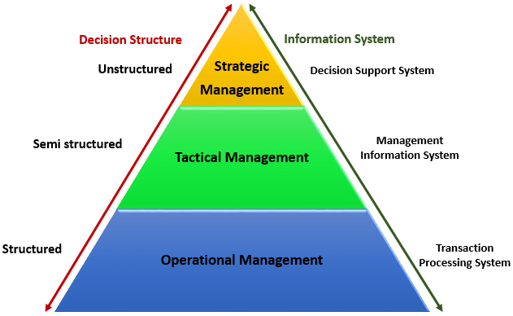
TYPES OF INFORMATION SYSTEMS

Slide 49
TYPES OF INFORMATION SYSTEMS
Transaction Processing Systems (TPS)
This type of information system is used to record the day to day transactions of a business.
Examples of transaction processing systems include;
Point of Sale Systems – records daily sales
Payroll systems – processing employees salary, loans management, etc.
Stock Control systems – keeping track of inventory levels
Airline booking systems – flights booking management
Management Information Systems (MIS)
Management Information Systems are used to guide tactic managers to make semi-structured decisions.
The output from the transaction processing system is used as input to the MIS system.
Examples of management information systems include;
Sales management systems – they get input from the point of sale system
Budgeting systems – gives an overview of how much money is spent within the organization for the short and long terms.
Human resource management system – overall welfare of the employees, staff turnover, etc.

Slide 50
TYPES OF INFORMATION SYSTEMS
Decision Support Systems (DSS)
Decision support systems are used by top level managers to make semi-structured decisions.
The output from the Management Information System is used as input to the decision support system.
DSS systems also get data input from external sources such as current market forces, competition, etc.
Examples of decision support systems include;
Financial planning systems – it enables managers to evaluate alternative ways of achieving goals. The objective is to find the optimal way of achieving the goal.
Bank loan management systems – it is used to verify the credit of the loan applicant and predict the likelihood of the loan being recovered.

Slide 51
TYPES OF INFORMATION SYSTEMS
An expert system is an information system that captures the expertise of workers and then simulates that expertise to the benefit of non-experts.
A communications and collaboration system is an information system that enables more effective communications between workers, partners, customers, and suppliers to enhance their ability to collaborate.
An office automation system is an information system that supports the wide range of business office activities that provide for improved work flow between workers.

Slide 52
Manual Information Systems VS Computerized Information Systems (MIS)
Data is the bloodstream of any business entity. Everyone in an organization needs information to make decisions.
An information system is an organized way of recording, storing data, and retrieving information.
Manual Information System
A manual information system does not use any computerized devices.
The recording, storing and retrieving of data is done manually by the people, who are responsible for the information system.

Slide 53
Manual Information Systems
The following are the major components of a manual information system
People –people are the recipients of information system
Business Procedures –these are measures put in place that define the rules for processing data, storing it, analyzing it and producing information
Data –these are the recorded day to day transactions
Filing system – this is an organized way of storing information
Reports –the reports are generated after manually analyzing the data from the filing system and compiling it.

Slide 54
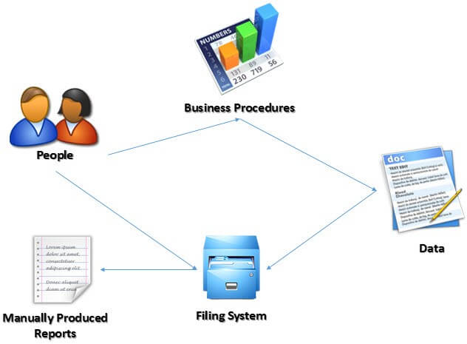
Illustration of Manual Information System

Slide 55
Advantages of Manual Information System
The following are the advantages of manual information systems
Cost effective – it is cheaper compared to a computerized system because there is no need to purchase expensive equipment such as servers, workstations, printers, etc.
Flexible –evolving business requirements can easily be implemented into the business procedures and implemented immediately

Slide 56
Disadvantages of Manual Information System
Time consuming –all data entries need to be verified before filing, this is a time consuming task when done by humans.
Retrieving data from the filing system also takes a considerable amount of time
Prone to error – the accuracy of the data when verified and validated by human beings is more prone to errors compared to verification and validation done by computerized systems.
Lack of security – the security of manual systems is implemented by restricting access to the file room.
Experience shows unauthorized people can easily gain access to the filing room
Duplication of data –most departments in an organization need to have access to the same data. In a manual system, it is common to duplicate this data to make it easy to accessible to all authorized users.
The challenge comes in when the same data needs to be updated
Data inconsistency – due to the duplication of data, it is very common to update data in one file and not update the other files.
This leads to data inconsistency
Lack of backups – if the file get lost or mishandled, the chances of recovering the data are almost zero.

Slide 57
Computerized Information Systems
Computerized systems were developed to address the challenges of manual information systems.
The major difference between a manual and computerized information system is a computerized system uses a combination of software and hardware to record, store, analyze and retrieve information.

Slide 58
Advantages of Computerized Information Systems
Fast data processing and information retrieval – this is one of the biggest advantages of a computerized information system.
It processes data and retrieves information at a faster rate. This leads to improved client/customer service
Improved data accuracy – easy to implement data validation and verification checks in a computerized system compared to a manual system.
Improved security – in addition to restricting access to the database server, the computerized information system can implement other security controls such as user’s authentication, biometric authentication systems, access rights control, etc.
Reduced data duplication – database systems are designed in such a way that minimized duplication of data.
This means updating data in one department automatically makes it available to the other departments
Improved backup systems – with modern day technology, backups can be stored in the cloud which makes it easy to recover the data if something happened to the hardware and software used to store the data
Easy access to information – most business executives need to travel and still be able to make a decision based on the information.
The web and Mobile technologies make accessing data from anywhere possible.

Slide 59
Disadvantages of Computerized Information Systems
It is expensive to set up and configure – the organization has to buy hardware and the required software to run the information system.
In addition to that, business procedures will need to be revised, and the staff will need to be trained on how to use the computerized information system.
Heavy reliance on technology – if something happens to the hardware or software that makes it stop functioning, then the information cannot be accessed until the required hardware or software has been replaced.
Risk of fraud – if proper controls and checks are not in place, an intruder can post unauthorized transactions such as an invoice for goods that were never delivered, etc.

Slide 60
SYSTEM DEVELOPMENT LIFE CYCLE (SDLC)
System Development life cycle is an organizational process of developing and maintaining systems.
It helps in establishing a system project plan, because it gives overall list of processes and sub-processes required for developing a system.
What is System Development life cycle?
The process of developing software to meet a need or solve a problem.
Is a systematic process for building software that ensures the quality and correctness of the software built.

Slide 61
Why SDLC?
Here, are prime reasons why SDLC is important for developing a software system.
It offers a basis for project planning, scheduling, and estimating
Provides a framework for a standard set of activities and deliverables
It is a mechanism for project tracking and control
Increases visibility of project planning to all involved stakeholders of the development process
Increased and enhance development speed
Improved client relations
Helps you to decrease project risk and project management plan overhead

Slide 62
STAGES/PHASES OF SYSTEM DEVELOPMENT LIFE CYCLE (SDLC)
Phase 1: Requirement collection and analysis:
The requirement is the first stage in the SDLC process.
It is conducted by the senior team members with inputs from all the stakeholders and domain experts in the industry.
Planning for the quality assurance requirements and recognition of the risks involved is also done at this stage.
This stage gives a clearer picture of the scope of the entire project and the anticipated issues, opportunities, and directives which triggered the project.
Requirements Gathering stage need teams to get detailed and precise requirements. This helps companies to finalize the necessary timeline to finish the work of that system.

Slide 63
STAGES/PHASES OF SYSTEM DEVELOPMENT LIFE CYCLE (SDLC)
Phase 2: Feasibility study:
Once the requirement analysis phase is completed the next step is to define and document software needs.
This process conducted with the help of 'Software Requirement Specification' document also known as 'SRS' document.
It includes everything which should be designed and developed during the project life cycle.
There are mainly five types of feasibilities checks:
Economic: Can we complete the project within the budget or not?
Legal: Can we handle this project as cyber law and other regulatory framework/compliances.
Operation feasibility: Can we create operations which is expected by the client?
Technical: Need to check whether the current computer system can support the software
Schedule: Decide that the project can be completed within the given schedule or not.

Slide 64
STAGES/PHASES OF SYSTEM DEVELOPMENT LIFE CYCLE (SDLC)
Phase 3: Design
In this third phase, the system and software design documents are prepared as per the requirement specification document.
This helps define overall system architecture.
This design phase serves as input for the next phase of the model.
Phase 4: Coding:
Once the system design phase is over, the next phase is coding. In this phase, developers start build the entire system by writing code using the chosen programming language.
In the coding phase, tasks are divided into units or modules and assigned to the various developers.
It is the longest phase of the Software Development Life Cycle process.
In this phase, Developer needs to follow certain predefined coding guidelines.

Slide 65
STAGES/PHASES OF SYSTEM DEVELOPMENT LIFE CYCLE (SDLC)
Phase 5: Testing:
Once the software is complete, and it is deployed in the testing environment.
The testing team starts testing the functionality of the entire system. This is done to verify that the entire application works according to the customer requirement.
During this phase, QA and testing team may find some bugs/defects which they communicate to developers.
The development team fixes the bug and send back to QA for a re-test.
This process continues until the software is bug-free, stable, and working according to the business needs of that system.

Slide 66
STAGES/PHASES OF SYSTEM DEVELOPMENT LIFE CYCLE (SDLC)
Phase 6: Installation/Deployment:
Once the software testing phase is over and no bugs or errors left in the system then the final deployment process starts.
Based on the feedback given by the project manager, the final software is released and checked for deployment issues if any.
Phase 7: Maintenance:
Once the system is deployed and customers start using the developed system, the following 3 activities occur;
Bug fixing - bugs are reported because of some scenarios which are not tested at all
Upgrade - Upgrading the application to the newer versions of the Software
Enhancement - Adding some new features into the existing software

